Slide 1

Software Quality Assurance
Lab 9
REST-Assured

Slide 2
Agenda
Introduction to REST-Assured.
Difference between Postman and REST-Assured
HTTP Methods
Setup and Installation?
GET Method
POST Method
PUT Method
DELETE Method

Slide 3
Introduction to REST-Assured
REST Assured is a Java library that provides a domain-specific language (DSL) for writing powerful, maintainable tests for RESTful APIs.
REST-Assured benefits:
REST-Assured simplifies the testing process by allowing developers to validate various aspects of API responses such as status codes, response bodies, headers, and more.
The library supports HTTP methods like GET, POST, PUT, DELETE, PATCH, etc., making it versatile for testing different types of API endpoints.
REST-Assured can be integrated seamlessly into existing Java projects and test suites, making it a preferred choice for API automation testing among Java developers.
Notes:
A Domain Specific Language is a programming language with a higher level of abstraction optimized for a specific class of problems.

Slide 4
Postman VS Rest-Assured
Postman
Rest assured
Postman is a standalone tool that provides (GUI) for testing APIs.
It allows you to create and send requests to APIs, organize your requests into collections, set up automated testing using scripts, and generate documentation for your APIs.
Postman is available as a desktop application (Windows, macOS, Linux) as well as a web-based version.
Postman can be used for manual testing, as well as for setting up automated tests using scripts (JavaScript).
REST-Assured is a Java library for testing RESTful APIs.
It allows you to write tests in Java code, making it suitable for integration with Java test frameworks like JUnit or TestNG.
It integrates well with popular Java development tools and frameworks, making it a preferred choice for Java developers.
REST-Assured offers a high level of flexibility and control over your API testing process, but it requires programming knowledge in Java.

Slide 5
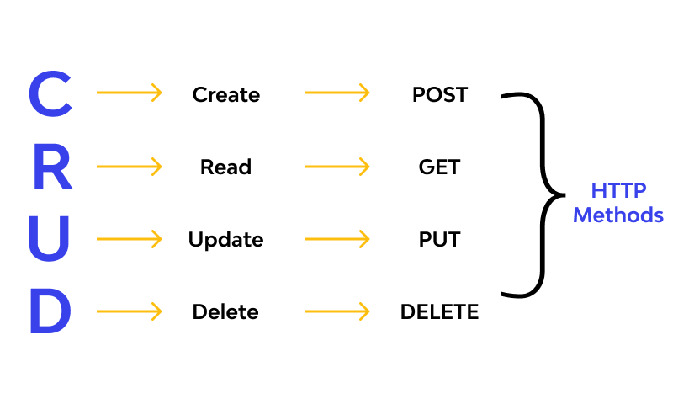
HTTP Methods
HTTP methods (GET, PUT, POST and DELETE) can be mapped to CRUD operations.
The four basic functions that models should be able to do, at most.

Slide 6
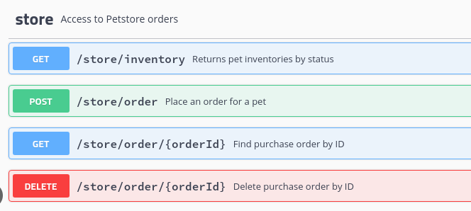
HTTP Request
HTTP Request mainly contains the HTTP method and the requested URL

Slide 7
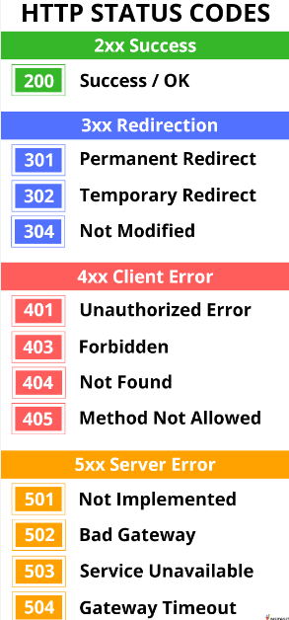
HTTP Response
HTTP Response mainly contains the status code and the content type.
Status code is a 3-digit integer where the first digit defines the class of response.

Slide 8
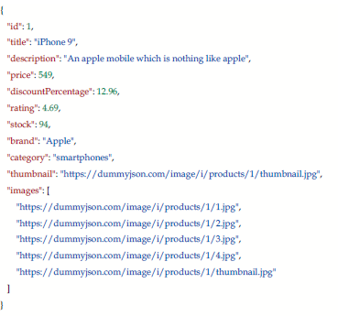
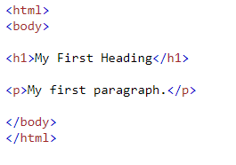
HTTP Response (cont.)
Content type contains the type of returned content. It can be text/html or application/json

Slide 9
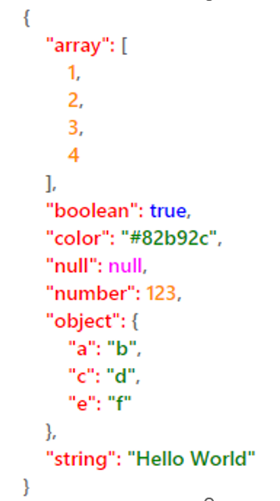
JSON
JSON stands for JavaScript Object Notation
It is a text format for storing and transporting data
Data is in name/value pairs
Data is separated by commas
Curly braces hold objects
Square brackets hold arrays

Slide 10
REST-Assured Installation
To get started with REST Assured, simply add it as a dependency to your project.
Add the following entry to your pom.xml
Once the dependency is added, ensure your project is configured to use TestNG for running tests.
<dependency> <groupId>io.rest-assured</groupId> <artifactId>rest-assured</artifactId> <version>5.4.0</version> <scope>test</scope> </dependency>

Slide 11
The Final POM
All these dependencies must be in POM file to get started with REST Assured
<dependency>
<groupId>org.testng</groupId>
<artifactId>testng</artifactId>
<version>7.6.0</version>
<scope>test</scope>
</dependency>
<dependency>
<groupId>com.googlecode.json-simple</groupId>
<artifactId>json-simple</artifactId>
<version>1.1.1</version>
</dependency>
</dependency>
<dependency>
<groupId>io.rest-assured</groupId>
<artifactId>rest-assured</artifactId>
<version>5.4.0</version>
<scope>test</scope>
</dependency>

Slide 12
HTTP Method -GET
GET requests are commonly used to fetch resources from the server.
In API testing, GET requests are often used to verify the correctness of resource retrieval, ensuring that the expected data is returned.
Testing GET requests involves verifying the response status code, response body, and optionally response headers.

Slide 13
HTTP Method -GET
Sending a GET request ( https://reqres.in/api/users?page=2)
Validating response status code
Extracting response body
Verifying response headers

Slide 14
HTTP Method -GET
package com.vogella.maven.projectTest;
import static io.restassured.RestAssured.given;
import static org.hamcrest.Matchers.equalTo;
import static org.hamcrest.Matchers.hasItems;
import org.testng.annotations.Test;
import io.restassured.RestAssured;
import io.restassured.http.ContentType;
import io.restassured.response.Response;
import junit.framework.Assert;
import org.json.simple.JSONObject;

Slide 15
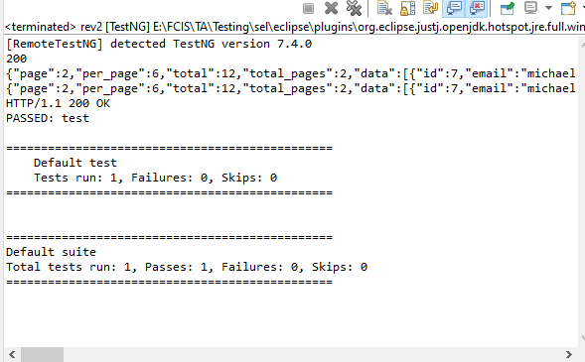
HTTP Method -GET
public class Test_Get {
@Test
public void test() {
Response response = RestAssured.get("https://reqres.in/api/users?page=2");
System.out.println(response.statusCode());
System.out.println(response.asString());
System.out.println(response.getBody().asString());
System.out.println(response.statusLine());
int statusCode = response.getStatusCode();
Assert.assertEquals(statusCode, 200);
}}
Notes:
The start line of an HTTP response, called the status line, contains the following information: The protocol version, usually HTTP/1.1 , but can also be HTTP/1.0 . A status code, indicating success or failure of the request.

Slide 16
Given – When – Then?
The Given-When-Then formula is a template intended to guide the writing of acceptance tests for a User Story:
(Given) some context
(When) some action is carried out
(Then) a particular set of observable consequences should obtain
The fluent API used by REST Assured supports the familiar Given/When/Then syntax , resulting in a test that is easy to read and takes care of everything (setup, execution, and verification) with just a single line of code.

Slide 17
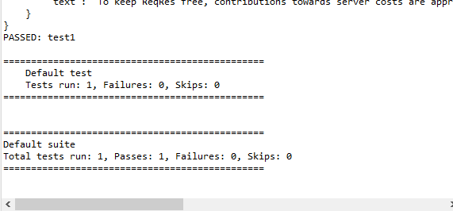
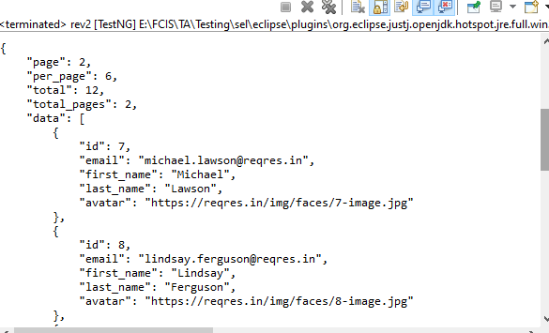
HTTP Method –GET
With given() when() then()
public class Test_Get {
@Test
public void test1() {
given().
when().
get("https://reqres.in/api/users?page=2").
then().
statusCode(200);
}}

Slide 18
Validating technical response data
With REST Assured, you can not only verify response body contents, but also check the correctness of technical response data, such as the HTTP response status code, the response content type, and other response headers. The example below checks that:
The response status code is equal to 200.
The response content type (telling the receiver of the response how to interpret the response body) equals "application/json."
The value of the response header “Content-Encoding" equals “gzip"

Slide 19
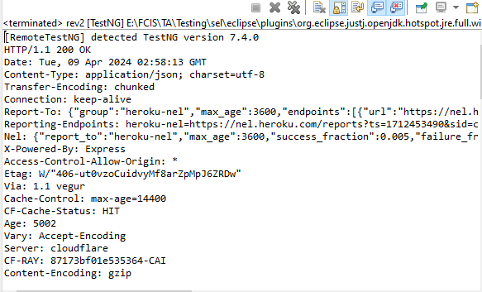
HTTP Method –GET
public class Test_Get {
@Test
public void test1() {
given().
when().
get("https://reqres.in/api/users?page=2").
then().
statusCode(200).
body("data.id[1]", equalTo(8)).
body("data.first_name", hasItems("Michael","Lindsay")).
contentType(ContentType.JSON).
header("Content-Encoding",equalTo("gzip")).
log().all();
}}
Notes:
To log all request specification details including parameters, headers, and body of the request, log(). all() needs to be added post given() section. This will print the response body regardless if an error occurred.

Slide 20
HTTP Method -Post
POST requests are crucial for testing resource creation operations.
In API testing, POST requests are used to validate that new resources are created successfully on the server.
Testing POST requests involves verifying the response status code(201), response body for any returned resource details, and potentially response headers.

Slide 21
HTTP Method -POST
Sending a POST request with parameters ( https://reqres.in/api/users)
Verifying response status code
Notes:
200 : OK : Request has succeeded
201 : Created : Request has succeeded and a new resource has been created

Slide 22
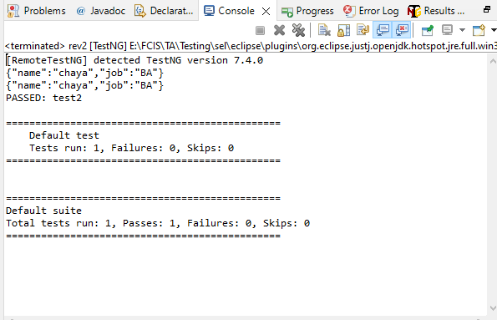
HTTP Method -POST
public class Test_Post {
@Test
public void test2() {
JSONObject request = new JSONObject();
request.put("name", "chaya");
request.put("job", "BA");
System.out.println(request);
System.out.println(request.toString());
given().
body(request.toJSONString()).
when().
post("https://reqres.in/api/users").
then().
statusCode(201 );}}

Slide 23
HTTP Method -PUT
PUT requests are used to modify data.
In API testing, PUT requests can be used to add new data.
Testing PUT requests involves verifying the response status code(200)

Slide 24
HTTP Method -PUT
Sending a PUT request with parameters ( https://reqres.in/api/users/2)
Verifying response status code
Notes:
200 : OK : Request has succeeded

Slide 25
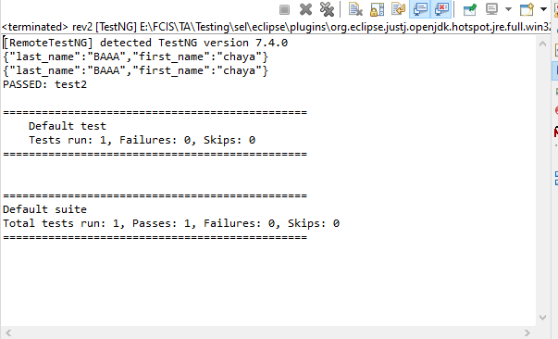
HTTP Method -PUT
public class Test03_Put {
@Test
public void test2() {
JSONObject request = new JSONObject();
request.put("first_name", "chaya");
request.put("last_name", "BAAA");
System.out.println(request);
System.out.println(request.toString());
given().
body(request.toJSONString()).
when().
put("https://reqres.in/api/users/2").
then().statusCode(200);}}

Slide 26
HTTP Method -DELETE
DELETE requests are used to delete data.
Testing delete requests involves verifying the response status code(204)

Slide 27
HTTP Method - DELETE
Sending a DELETE request with parameters ( https://reqres.in/api/users/2)
Verifying response status code
Notes:
204 : NO Content

Slide 28
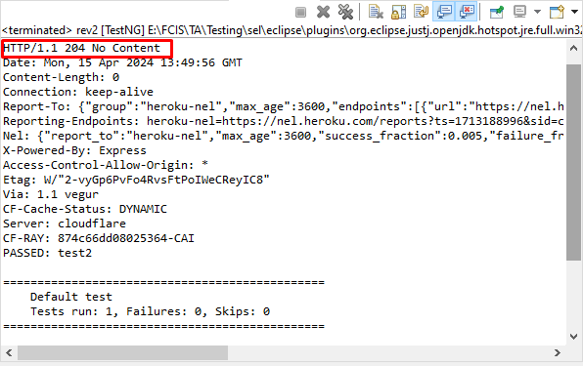
HTTP Method - DELETE
public class Test05_Delete {
@Test
public void test2() {
JSONObject request = new JSONObject();
given().
when().
delete("https://reqres.in/api/users/2").
then().statusCode(204).
log().all();}}

Slide 29
Thank You

